Slide 1
Economic Inquiry
Name
Tutor
Course
Date

Slide 2
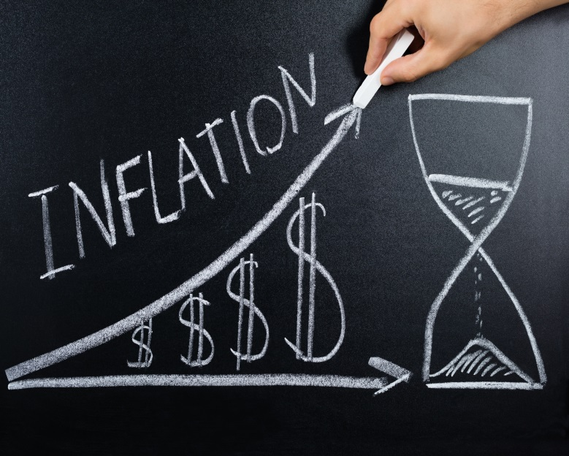
Introduction
The selected economic topic is inflation
Inflation is the steady increase in the price of goods and services
Is inflation bad for the economy?
Inflation may cause significant negative impacts on the economy (Coibion et al., 103297).
Notes:
The selected economic topic is inflation. Inflation refers to the steady increase in the price of goods and services within a given period (Coibion et al., 103297). The developed inquiry question from the selected topic is; is inflation bad for the economy? Inflation may have significant negative effects on the economy. Inflation may be a sign of a struggling economy, and it may worsen the economy further. Notably, inflation reduces the purchasing power, increases the cost of borrowing, increases unemployment, reduces investments, and reduces economic growth.

Slide 3
Reduced Purchasing Power
Inflation decreases purchasing power due to an increase in prices
As a result, the number of goods and services one can buy reduces
Businesses incur losses due to low purchasing power
An economic crisis may arise (Ndoricimpa 67)
Notes:
Purchasing power refers to currency value expressed on the basis of the number of goods and services one money unit can purchase. Inflation decreases purchasing power due to an increase in prices. Notably, when the prices for goods and services increase, people, especially those with limited financial resources, reduce the number of goods and services they purchase (Ndoricimpa 67). Consequently, manufacturers or producers, wholesalers, and retailers incur losses due to a reduction in sales. When businesses are not growing, the economy is also not growing. Business organizations contribute high amounts of revenue to the government, and when they are making losses, some may close down, and the revenue remitted to the government is lost. As a result, economic growth slows down.

Slide 4
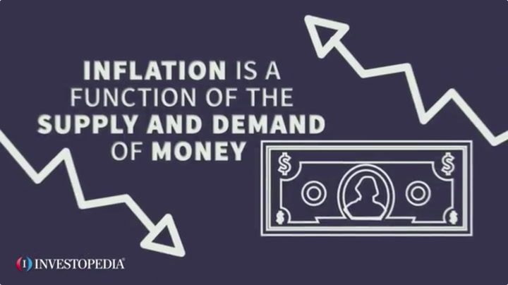
Increased Cost of Borrowing
A high interest rate controls high inflation.
When interest rates are high, the cost of borrowing money increases
As a result, loans become expensive
Borrowing declines (Brown 50)
Notes:
High inflation affects the cost of borrowing money. Central banks use a high rate of interest in controlling inflation. Interest refers to money paid for borrowed funds. Therefore, when inflation becomes high, interest rates are also raised. As a result, borrowing becomes expensive. In addition, due to the high cost of borrowed funds, borrowing reduces, and the supply of money also reduces (Brown 50). A decline in the supply of money implies that people will have little to buy goods and services. When the demand for goods and services reduces, supply also reduces. Generally, revenues remitted to the government by both individuals and business organizations also reduce.

Slide 5
Increased Unemployment
High inflation reduces the purchasing power
Businesses may close down
High inflation reduces economic growth
Reduced economic growth implies a high rate of unemployment (Van 767).
Notes:
A high inflation rate implies that the cost of goods and services is higher. As a result, purchasing power reduces. When the purchasing power declines, the demand for goods and services declines. Declining demand for goods and services, in turn, reduces the supply of such goods. As a result, business organizations may close down to avoid operating at losses. When businesses close down, people are declared jobless, and the rate of unemployment increases. Also, when businesses close down, the rate of economic growth reduces since people lose income and the government loses revenues (Van 767). A slow economic growth rate is also an implication of a high rate of unemployment.

Slide 6
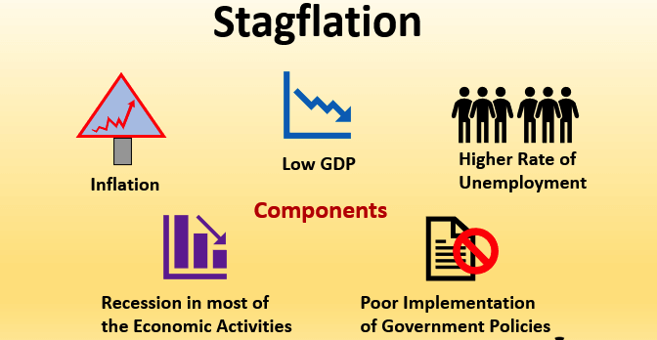
Reduced Investments
High inflation increases interest rates
Loans become expensive
Borrowing reduces
Investments also reduce (Brown, 2018)
Notes:
Increasing inflation causes a subsequent increase in interest rates. The majority of the investors depend on loans to initiate, implement, and sustain different investment portfolios. Therefore, when loans are expensive, borrowing declines, and in turn, the rate of investment reduces. Additionally, when inflation is high, cash flows from fixed assets perform poorly because the purchasing power of long-term cash flows reduces over time. Most investors also buy securities with fixed income like bonds and treasuries since they anticipate a stable income flow in terms of interest payments (Brown, 2018). However, because interest rates remain constant for the majority of securities with fixed income until their maturity, higher inflation reduces the purchasing power of the interest paid on such securities. A high inflation rate and a high unemployment rate result in what is referred to as stagflation.

Slide 7
Reduced Economic Growth
A high unemployment rate slows economic growth
A high interest rate implies low investments
Reduced investments also reduce economic growth
Low purchasing power may also cause an economic crisis (Coibion et al., 103297).
Notes:
A high inflation rate may lead to slow economic growth. Notably, when the rate of inflation is high, interest rates become high. As a result, loans become expensive and borrowing declines. This causes a direct decline in investments. Ideally, low interest rates encourage investments, and the economy is bound to grow. However, when people are not able to borrow to invest, the rate of economic growth may reduce. Besides, when interest rates are high, the purchasing power reduces, causing a decline in the demand for goods and services (Coibion et al., 103297). The decline in the demand for goods and services reduced supply, and businesses may close down. When businesses close down, people become jobless. Business closure also slows economic growth.

Slide 8
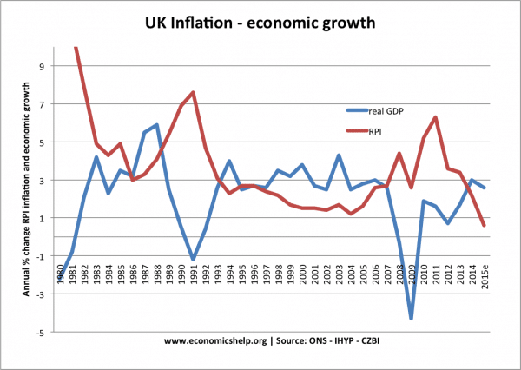
Conclusion
Inflation may be bad for the economy
Inflation increases interest rates
Inflation reduces the purchasing power
Inflation slows economic growth
Notes:
In summation, inflation may be bad for the economy. This is so because inflation increases interest rates, reduces purchasing power, reduces investments, and contributes to high levels of unemployment. Notably, central banks use high interest rates in controlling high rates of inflation. When interest rates increase, the cost of borrowed money increases. As a result, people shy away from borrowing, and the rate of investments reduce. A low rate of investments implies slow economic growth. Additionally, a high inflation rate reduces the purchasing power of consumers. Consequently, the demand for goods and services decline, leading to the closure of business ventures.

Slide 9
References
Brown, Pablo Pincheira. "Exchange rate interventions and inflation expectations in an inflation targeting economy." Revista de Análisis Económico–Economic Analysis Review 33.2 (2018): 43-78.
Coibion, Olivier, et al. "Inflation expectations as a policy tool?." Journal of International Economics 124 (2020): 103297.
Ndoricimpa, Arcade. "Threshold effects of inflation on economic growth in Africa: Evidence from a dynamic panel threshold regression approach." African Development Bank Group, Working Paper 249 (2017): 34-109.
Van, Dinh Doan. "Money supply and inflation impact on economic growth." Journal of Financial Economic Policy (2019): 767.

